Slide 1
Unclassified
Platform Translation Layer Milestone 1 Investigation
Milestone 1: Platform Translation Layer
By: Helen Guerrero
09/16/2024
Unclassified

Slide 2
Platform Translation Layer Milestone 1 Requirements
unclassified
The platform translation layer shall receive radar action control messages/signal processing commands/data processing commands from the platform scheduler within a standard messaging format.
The platform translation layer shall translate radar action control messages/signal processing commands and execution time into an appropriate sensor execution command (e.g. a STIM) within the framework of the front end software/hardware (e.g. GNU radio, UHD-USRP or similar software for milestone 1). The platform translation layer shall communicate the sensor execution command to the appropriate sensor identified in the in the request.
The platform translation layer shall store the ID’s of incoming radar action control message, signal and data processing commands for labeling corresponding return data from the sensor platform.
The platform translation layer shall receive status updates of the sensor platform executing or denying a sensor event, along with the time of execution. The platform translation layer shall package status update with original radar action control message ID and send to the platform scheduler.
The platform translation layer shall extract sensor measurement report and package with original radar action control message ID and data processing commands (e.g. instructions for unit conversion, coordinate transformation, resampling) to be sent to platform data services for further formatting.
unclassified

Slide 3
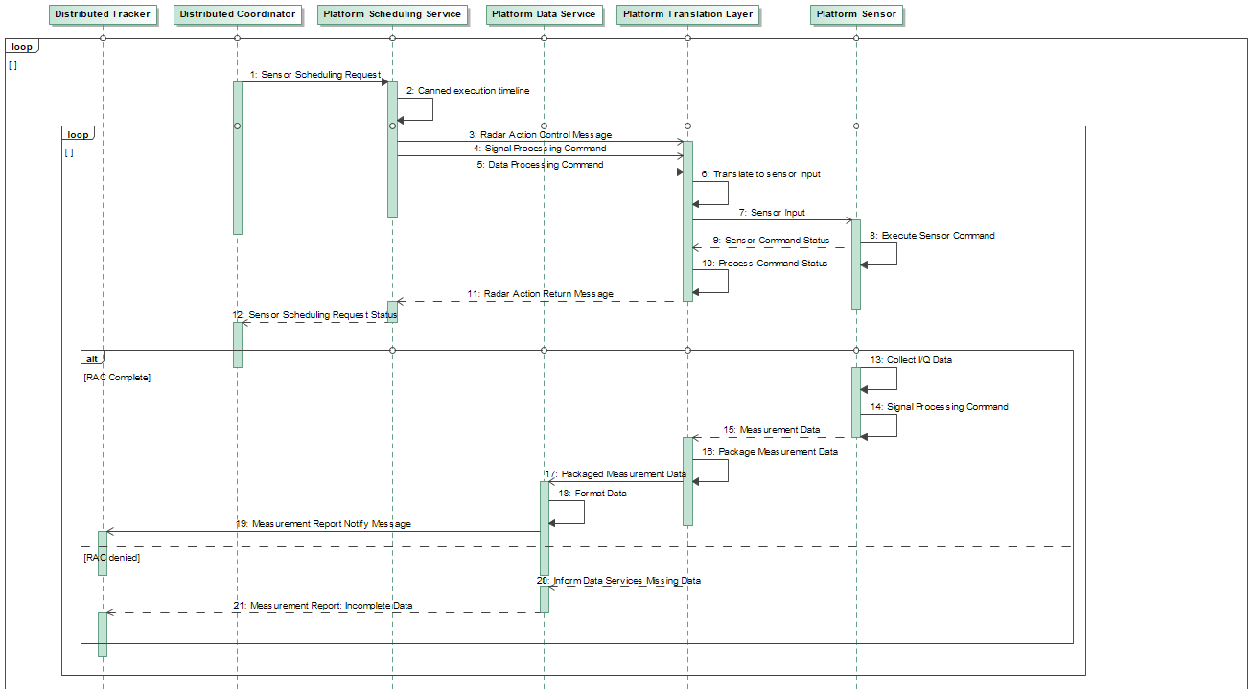
Milestone 1 Platform Services Architecture
unclassified
1: DC specifies ID of sensor to be commanded. DC selects set of ID’s from library of element commands, beam commands, tx-rx commands and signal processing commands for canned scheduling request with canned windows of opportunity.
2-5: Platform Scheduling service translates scheduling request into a series of radar action control messages, labeled by ID. Execution times are set to be the time requested by the DC; signal/data processing commands for associated radar action messages are attached.
6-7: Platform Translation Layer translates radar action control message and signal processing message into sensor command (e.g. STIM) using a stored dictionary. Platform Translation Layer stores relevant data processing commands for future data processing to be sent to Platform Data Services with the sensor’s return data in step 15.
8-9: Sensor reports back status, antenna data and execution time of sensor command (if accepted) or updates status (if denied).
10-12: Platform Translation Layer reports status, execution time and ID of RAC message back to platform scheduling service. Platform scheduler reports status of original scheduling request ID to distributed coordinator.
13-14: Sensor platform outputs I/Q data and host computer performs signal processing (TBD).
15-17: Platform Translation Layer extracts sensor data and packages with RAC/data processing message ID within the translation layer and sends to platform data services.
18-19: Platform data services receives and formats data according to the instruction from the platform translation layer and sends sensor data report to data recorder.
20-21: If the sensor command was denied, report of denial is sent to the distributed tracker.
unclassified

Slide 4
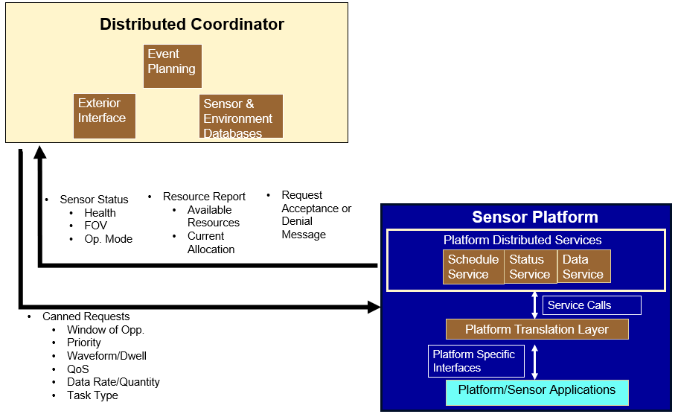
PTL Main Objective
Unclassified
Platform/Sensor Applications: GNU Radio
Transforms requests to sensor specific language: UHD
PTL sends sensor command input to front end for sensor event execution
In the context of Milestone 1, the PTL shall communicate with the GNU Radio
flowgraph named Darc Dish Dual Node Pol which is used to
transmit, receive, detect, etc.
Unclassified

Slide 5
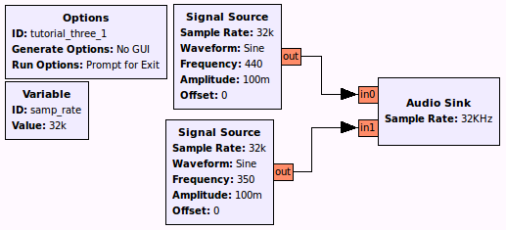
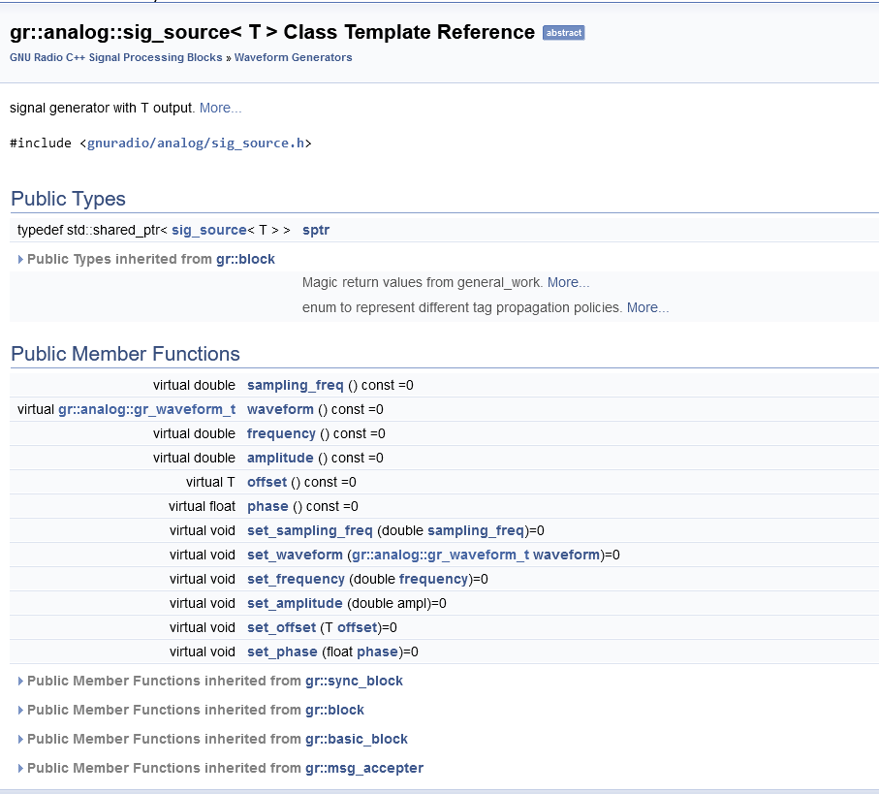
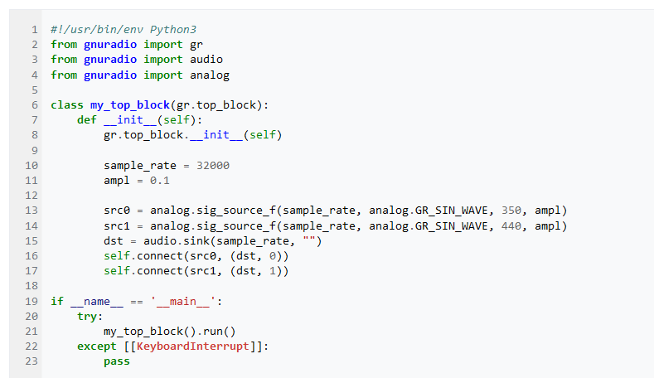
GNU Radio Quick Overview
UNCLASSIFIED
Source: https://www.gnuradio.org/about/
“GNU Radio is a free software development toolkit that provides signal processing blocks to implement software-defined radios and signal processing systems”
Each individual square is called a block. Blocks are connected to each other with arrows.
The properties defining each block are written in python, but implementation is done in C++.
UNCLASSIFIED

Slide 6
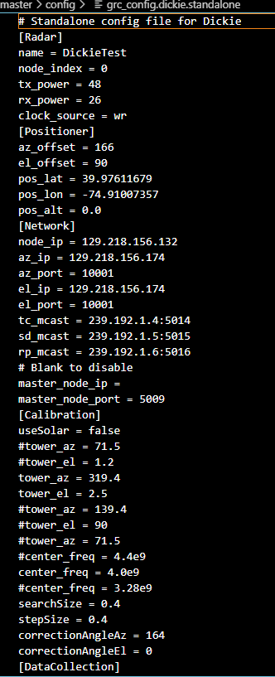
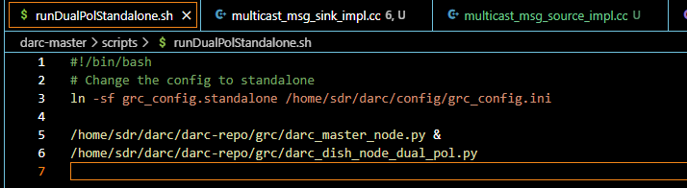
How Lab 142 Tx/Rx using GNU Radio (Summarized)
UNCLASSIFIED
Source: https://lmco-confldc.us.lmco.com:8443/display/DAPT/Standalone+Radar+Operation+Steps
Run bash script named runDualPolStandalone.sh from terminal
This script contains grc flowgraphs which are generated to python code.
The scripts brings up 2 GUIs, one being the DARC Master Node Gui and the other the GUI with plots, range, etc.
The config file defines radar specific parameters.
In the DARC Master Node GUI, input position (az/el), send position → This moves the dish
When ready to tx, check the HPA enable box in the DARC Master Node GUI
What does HPA stand for?
UNCLASSIFIED

Slide 7
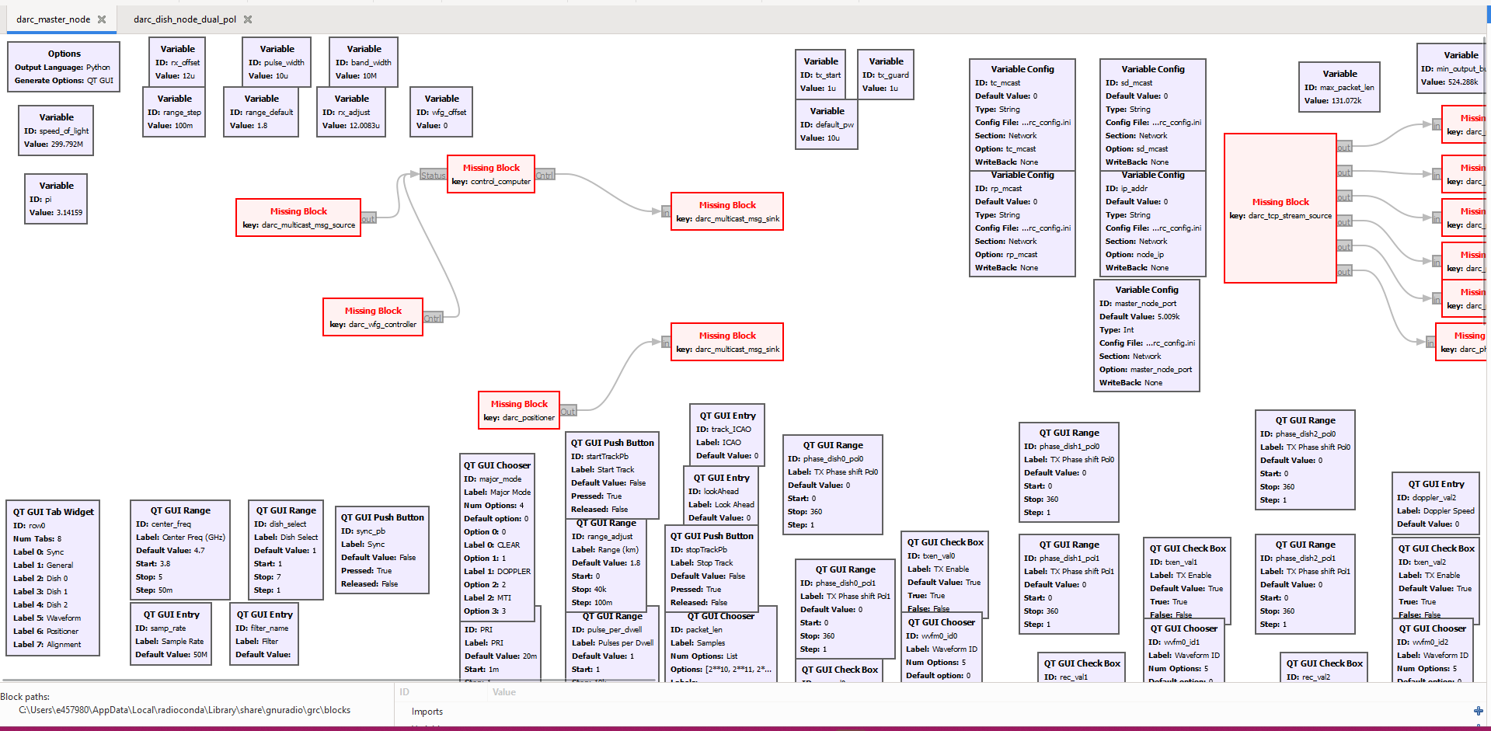
DARC Master Node Flowgraph
unclassified
The blocks in red are from a custom module named darc
unclassified

Slide 8
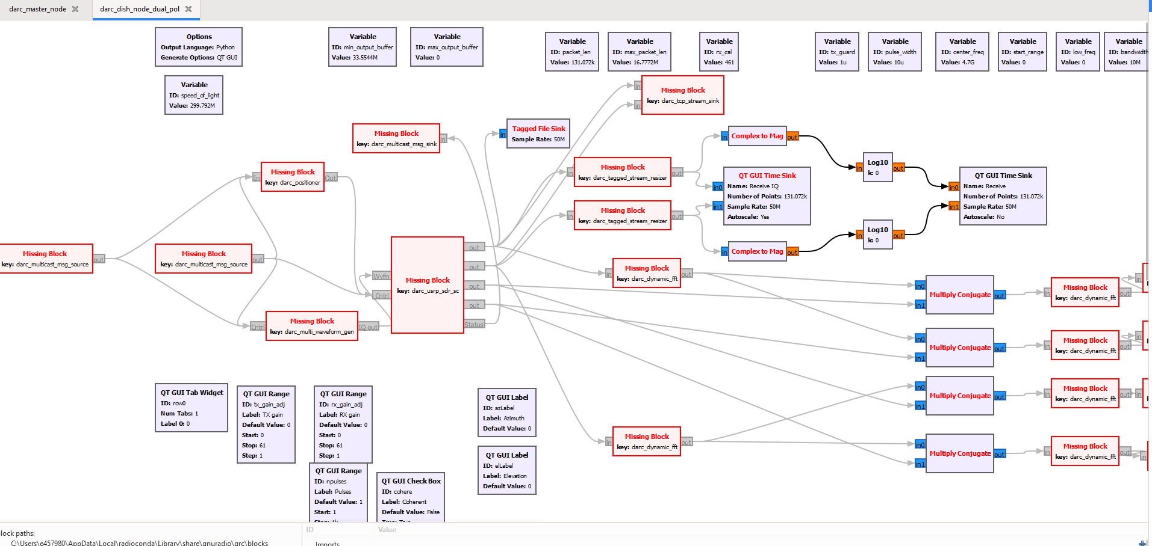
DARC Dish Dual Node Pol Flowgraph
unclassified
DARC Master Node sends a message that is received by DARC Dish Dual Node Pol through “darc_multicast_msg” blocks
unclassified

Slide 9
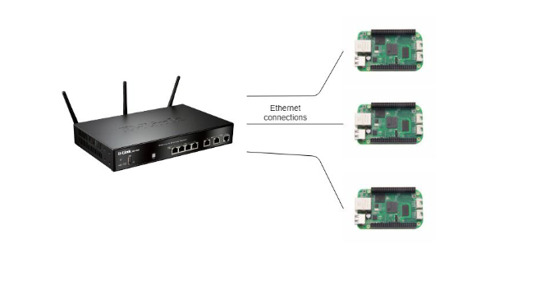
Multicast Messages Explained
unclassified
2 Types of multicast message blocks: Multicast Message Source and Multicast Message Sink
A sink is the terminating point of a flowgraph (swallows all data) and a source is the origin of a flowgraph (produces or ingests data)
Use multicast UDP to implement- data is sent once by UDP and it's received by as many clients that are interested, or listening.
UDP uses 2 parameters: IP Address and Port #
unclassified

Slide 10
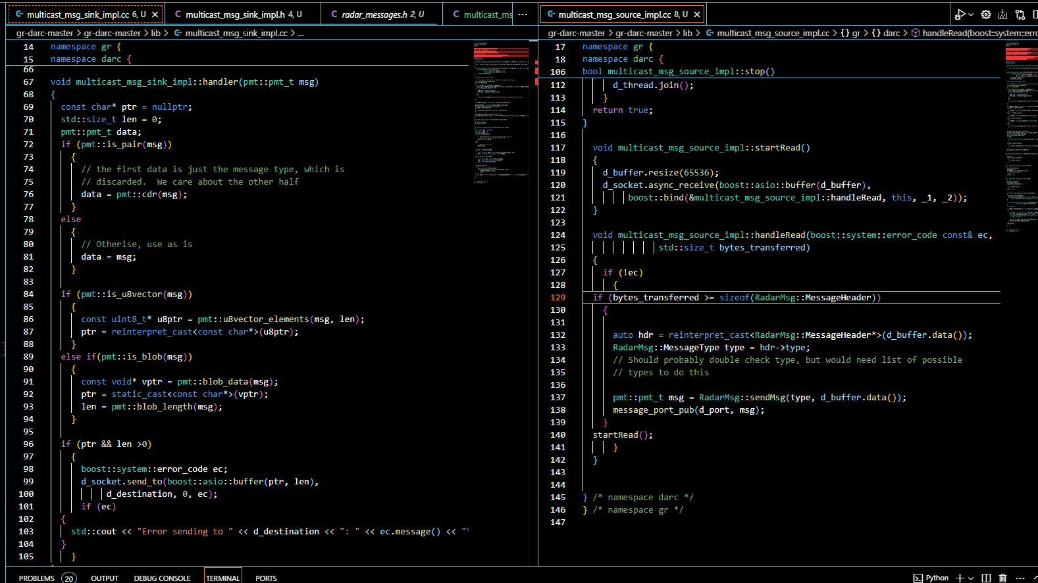
Multicast Messages Explained cont.
unclassified
unclassified

Slide 11
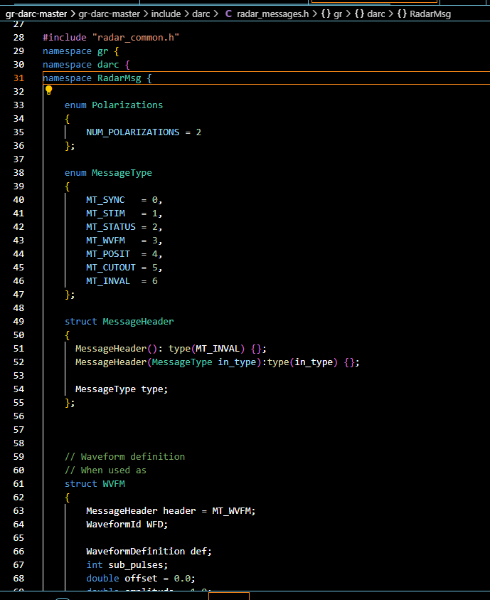
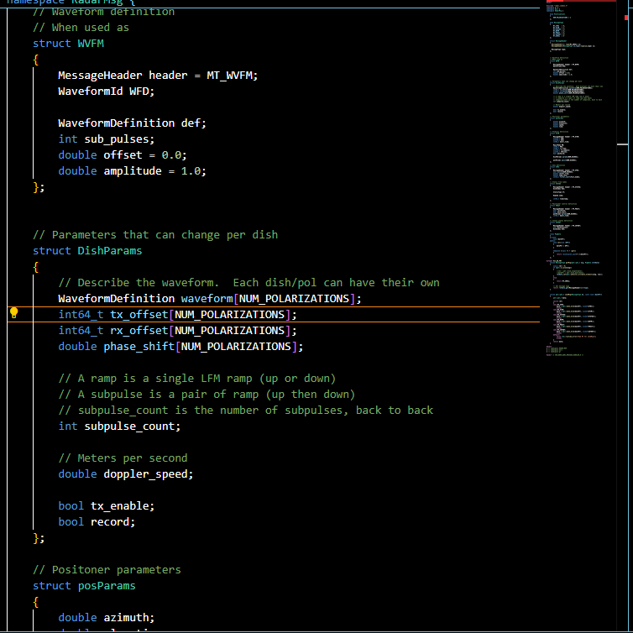
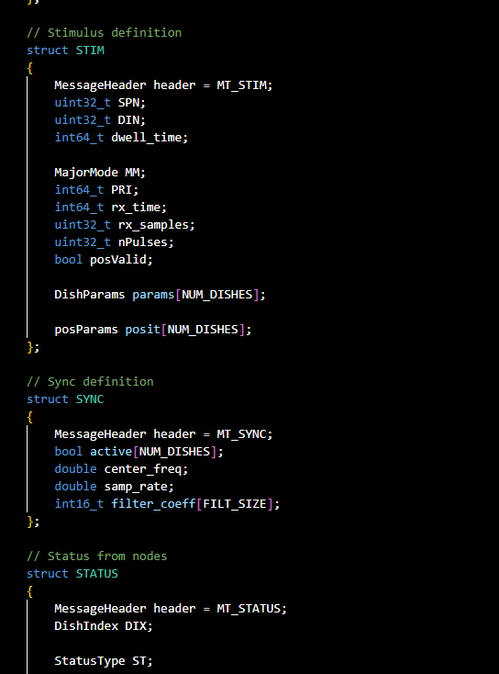
Radar Message
unclassified
Radar Message:
Message type, Waveform Type, Position Parameters, Status, etc
unclassified

Slide 12
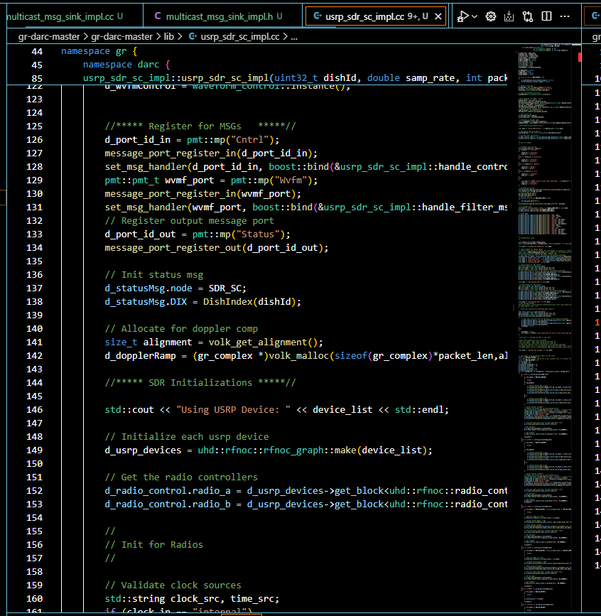
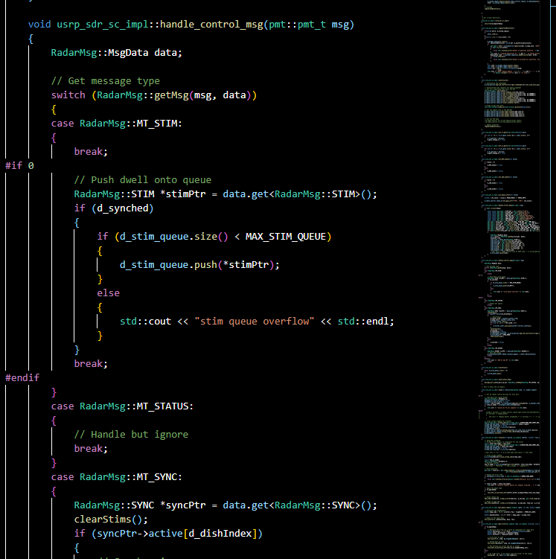
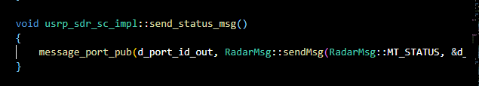
Radar Message → Hardware (Front End)
unclassified
1. Register for the message
2. Get message
3. Sends status message back
unclassified

Slide 13
Next Steps…
unclassified
Rewrite “Darc Master Node?”
Rewrite Radar Message?
Map Frost Messaging Standard to Radar Message Standard currently used?
Insert PTL Block into Darc Master Node that will take over and interfere with messaging protocol?
unclassified

Slide 14
UNCLASSIFIED
UNCLASSIFIED

